Slide 1
Reshma A
Final Project
3/21/2024 Annual Review

Slide 2
Project Title Fraud Detection In Insurance Claims Using RNN
3/21/2024 Annual Review

Slide 3


Agenda 1. Introduction to Fraud Detection 2. Overview of the Project 3. Identification of End Users 4. Our Solution and Its Value Proposition 5. The Wow Factor in Our Solution 6. Modelling Approach 7. Results and Performance Evaluation
3/21/2024 Annual Review

Slide 4

Problem Statement Detecting fraudulent insurance claims is a critical task for insurance companies to mitigate financial losses and maintain trust with their customers. Traditional methods often fall short in accurately identifying fraudulent claims due to their reliance on static rules and patterns. To address this challenge, employing Recurrent Neural Networks (RNNs) offers a promising solution. integrating RNNs into fraud detection systems for insurance claims holds great potential for enhancing detection accuracy and staying ahead of fraudulent activities.
3/21/2024 Annual Review

Slide 5

Project Overview In our project on fraud detection in insurance claims, we are leveraging the power of Recurrent Neural Networks (RNNs) to address the growing challenge of identifying fraudulent activities. Insurance fraud poses significant financial burdens on companies and policyholders alike, necessitating innovative solutions for detection and prevention. our project seeks to empower insurance companies with a robust fraud detection system capable of mitigating financial losses and preserving the integrity of the insurance industry.
3/21/2024 Annual Review

Slide 6

Who Are The End Users? - Insurance companies: Utilize RNNs to detect fraudulent claims and mitigate financial losses. - Claims investigators: Benefit from RNNs to streamline the investigation process by flagging suspicious claims for further review. - Fraud analysts: Leverage RNNs to identify patterns and anomalies indicative of fraudulent behavior within insurance claims data.
3/21/2024 Annual Review

Slide 7
Your Solution And Its Value Proportion Our solution harnesses the power of Recurrent Neural Networks (RNNs) to revolutionize fraud detection in insurance claims. By employing RNNs, we can effectively model sequential data inherent in insurance claims, capturing subtle patterns indicative of fraudulent activity. This advanced approach enables us to detect fraud with unprecedented accuracy and efficiency, significantly reducing financial losses for insurance companies. our RNN-powered fraud detection solution represents a paradigm shift in the insurance industry, delivering unparalleled value by safeguarding against fraudulent claims and preserving trust in the insurance ecosystem.
3/21/2024 Annual Review

Slide 8

The Wow In Your Solution 1.Sequential Analysis: RNNs excel at processing sequential data, making them ideal for analyzing the sequential nature of insurance claims. 2.Adaptability: RNNs can adapt to changing patterns of fraud over time. As fraudsters evolve their tactics, RNNs can continuously learn and update their models to stay ahead of new fraudulent schemes. 3.Scalability: RNNs can scale to handle large volumes of data, allowing insurance companies to analyze millions of claims efficiently. This scalability ensures that the system remains effective even as the amount of data grows.
3/21/2024 Annual Review
8

Slide 9
Modelling
1. Data Preprocessing:
- Gather historical insurance claims data including information about claims, policyholders, transactions, etc.
- Clean the data by removing duplicates, handling missing values, and standardizing formats.
- Perform feature engineering to extract relevant features such as claim amount, claim type, policyholder demographics, etc.
Split the data into training, validation, and test sets.
2. Feature Encoding:
- Encode categorical features using techniques like one-hot encoding.
Scale numerical features to a similar range to ensure that they contribute equally during training.
3. Model Architecture:
- Utilize a RNN architecture for its ability to capture sequential patterns in the data.
- Design the RNN architecture with layers such as LSTM (Long Short-Term Memory) or GRU (Gated Recurrent Unit) to effectively model temporal dependencies.
3/21/2024 Annual Review
9

Slide 10
4. Training:
- Train the RNN model on the training data using techniques like mini-batch gradient descent.
- Monitor the model's performance on the validation set and adjust hyperparameters accordingly to prevent overfitting.
5. Evaluation:
- Evaluate the trained model on the test set to assess its performance in detecting fraudulent insurance claims.
- Calculate metrics such as accuracy, precision, recall, and F1-score to measure the model's effectiveness.
- Analyze the model's predictions and adjust thresholds if necessary to optimize for specific criteria
3/21/2024 Annual Review
10

Slide 11
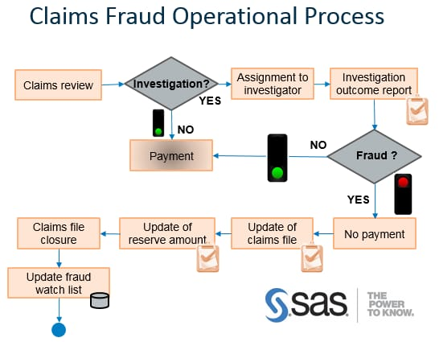

Slide 12
Result: 1. Detecting fraud in insurance claims is crucial for maintaining the integrity of the industry and preventing financial losses. Recurrent Neural Networks (RNNs) offer a promising approach for fraud detection due to their ability to capture sequential patterns in data. By analyzing historical insurance claims data, RNNs can learn patterns indicative of fraudulent behavior, such as unusual claim patterns or inconsistencies in reported information. 2. Through the application of RNNs, insurance companies can enhance their fraud detection capabilities, mitigate financial risks, and maintain trust with their policyholders.
3/21/2024 Annual Review
12

